Slide 1
Chapter 4: Preventive Maintenance and Troubleshooting
Instructor Materials
IT Essentials v7.0
Notes:
Cisco Networking Academy Program
IT Essentials 7.0
Chapter 4: Preventive Maintenance and Troubleshooting

Slide 2
Instructor Materials – Chapter 4 Planning Guide
This PowerPoint deck is divided in two parts:
Instructor Planning Guide
Information to help you become familiar with the chapter
Teaching aids
Instructor Class Presentation
Optional slides that you can use in the classroom
Begins on slide #12
Note: Remove the Planning Guide from this presentation before sharing with anyone.
Notes:
2

Slide 3
Chapter 4: Preventive Maintenance and Troubleshooting
IT Essentials 7.0 Planning Guide
Notes:
Cisco Networking Academy Program
IT Essentials v7.0
Chapter 4: Preventive Maintenance and Troubleshooting

Slide 4
Check Your Understanding and What Do You Already Know?
Check Your Understanding activities used to be called Interactive Activities. They simply have a new name. They are designed to let students quickly determine if they understand the content and can proceed, or if they need to review.
Check Your Understanding activities do not affect student grades.
Activities listed as What Do You Already Know? are a type of activity in which we ask the student to simply take a guess! It is not meant to evaluate their knowledge. It is only meant to give them a head start in thinking about different topics before they are presented in the course. Students receive addition content in the form of feedback for any answers they select.
What Do You Already Know? activities do not directly affect student grades; however, the feedback may contain content which appears later in quizzes and exams, so it is important that students complete the What Do You Already Know? activities.
There are no separate slides for these activities in the PPT. They are listed in the notes area of the slide that appears before these activities.
Notes:
4

Slide 5
Chapter 4: Activities
What activities are associated with this chapter?
Page # | Activity Type | Activity Name | Optional?
4.1.1.6 | Check Your Understanding | Preventive Maintenance | Recommended
4.2.1.4 | Check Your Understanding | Identify the Problem | Recommended
4.2.1.10 | Check Your Understanding | Number the Steps | Recommended
4.2.3.3 | Check Your Understanding | Reference Tools | Recommended
4.2.3.5 | Lab | Using a Multimeter and a Power Supply Tester | Recommended
4.2.3.6 | Lab | Troubleshoot Hardware Problems | Recommended
Notes:
5

Slide 6
Chapter 4: Assessment
Students should complete Chapter 4 “Assessment” after completing Chapter 4.
Quizzes, labs, and other activities can be used to informally assess student progress.
Notes:
6

Slide 7
Chapter 4: Best Practices
Prior to teaching Chapter 4, the instructor should:
Complete Chapter 4, “Assessment.”
The objectives of this chapter are:
Explain why preventive maintenance must be performed on personal computers.
Describe PC preventive maintenance.
Explain the benefits of preventive maintenance with regard to dust, internal components, and environmental concerns,.
Explain the benefits of preventive maintenance regarding software.
Troubleshoot problems with PC and Peripheral devices
Describe each step of the troubleshooting process.
Notes:
7

Slide 8
Chapter 4: Best Practices (Cont.)
Ask the IT department if students can perform preventive maintenance and clean computers in the school. Keyboards and monitors are especially popular in areas like the classroom and library.
Performing preventive maintenance on computers gives students a chance to practice concepts learned in prior chapters.
While cleaning the computer, tell the students to identify every port on the back of the computer. Share with a classmate what might attach to each port.
Identify internal components as they clean or put in teams and alternate between team members identifying parts.
Identify cables. Have each student provide one tip about a particular type of cable. Give an example such as the power cable that goes from the power supply to the motherboard. One student might suggest how tight it is to remove such a long cable. Another might suggest to press down on the clip before lifting upwards on the cable. Another might be the types of voltages that can be checked there is power is suspect.
Preventive maintenance is a great time to talk about recycling programs for electronic waste.
Notes:
8

Slide 9
Chapter 4: Best Practices (Cont.)
Preventive maintenance time is a great time to keep software updated and the security risks associated with out of date OS and/or apps.
In teams or individually, have students identify the steps of the troubleshooting process.
Have students provide examples common problems and solutions for PCs.
Students should be able to apply the troubleshooting process to computer components and peripherals.
Mention that troubleshooting is a learned process and a logical one. Give at least one example of something not working and walk through the process of what a technician might do to solve such a problem. Use one of the ones provided in the curriculum.
A good example of teaching the logic of troubleshooting is a flash drive not working. Many students work with removable media. Ask them how they know that is even a problem. Then ask what might be the problem if the drive isn’t recognized by the OS. If they don’t mention all of the possible solutions found in the curriculum, go over some of the ones related to new concepts such as the USB port might be disabled in BIOS or a virus is present.
Notes:
9

Slide 10
Chapter 4: Additional Help
For additional help with teaching strategies, including lesson plans, analogies for difficult concepts, and discussion topics, visit the ITE Community at: https://community.cisco.com/t5/networking-academy/ct-p/Netacad, or simply go to https://community.cisco.com.
If you have lesson plans or resources that you would like to share, upload them to the ITE Community in order to help other instructors.
Notes:
10

Slide 11
Chapter 4: Preventive Maintenance and Troubleshooting
IT Essentials v7.0
Notes:
Cisco Networking Academy Program
IT Essentials v7.0
Chapter 4: Preventive Maintenance and Troubleshooting

Slide 12
Chapter 4 - Sections & Objectives
4.1 Preventive Maintenance
Explain why preventive maintenance must be performed on personal computers.
Describe PC preventive maintenance.
4.2 Troubleshooting Process
Troubleshoot problems with PC and Peripheral devices
Describe each step of the troubleshooting process.
Identify common problems and solutions for PCs.
Troubleshoot computer components and peripherals using the six-step troubleshooting process.
Notes:
12
Cisco Networking Academy Program
IT Essentials v7.0
Chapter 4: Preventive Maintenance and Troubleshooting

Slide 13
4.1 Preventive Maintenance
Notes:
4 – Preventive Maintenance and Troubleshooting
4.1 – Preventive Maintenance

Slide 14
PC Preventive Maintenance Overview Benefits to Preventive Maintenance
Preventive maintenance plans are developed based on at least two factors:
Computer location or environment - Dusty environments, such as construction sites, requires more attention than an office environment.
Computer use - High-traffic networks, such as a school network, might require additional scanning and removal of malicious software and unwanted files.
Notes:
4.1 – Preventive Maintenance
4.1.1 – PC Preventive Maintenance Overview
4.1.1.1 – Benefits to Preventive Maintenance

Slide 15
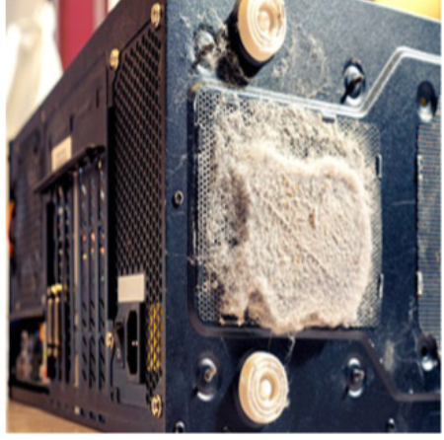
PC Preventive Maintenance Overview Preventive Maintenance - Dust
Use a cloth or a duster to clean the outside of the computer case. If using a cleaning product, put a small amount onto a cleaning cloth and then wipe the outside of the case.
Dust on the outside of a computer can travel through cooling fans to the inside.
Accumulated dust prevents the flow of air and reduces the cooling of components.
Hot computer components are more likely to break down.
Remove dust from the inside of a computer using a combination of compressed air, a low-air-flow ESD vacuum cleaner, and a small lint-free cloth.
Notes:
4.1 – Preventive Maintenance
4.1.1 – PC Preventive Maintenance Overview
4.1.1.2 – Preventive Maintenance - Dust

Slide 16
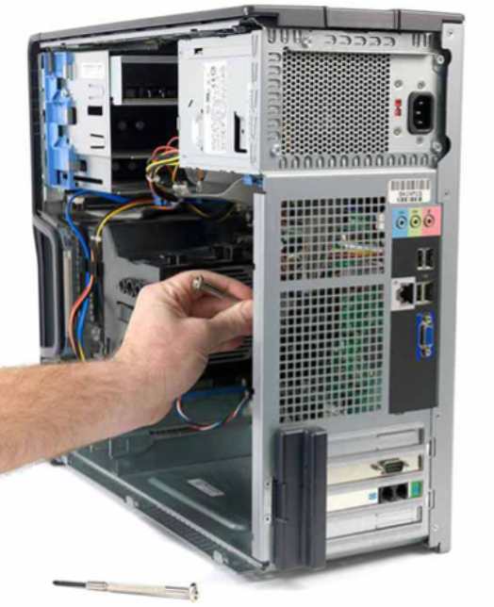
PC Preventive Maintenance Overview Preventive Maintenance – Internal Components
A basic checklist of components to inspect for dust and damage includes:
CPU heat sink and fan assembly
RAM modules
Storage devices
Adapter cards
Cables
Power devices
Keyboard and mouse
Notes:
4.1 – Preventive Maintenance
4.1.1 – PC Preventive Maintenance Overview
4.1.1.3 – Preventive Maintenance – Internal Components

Slide 17
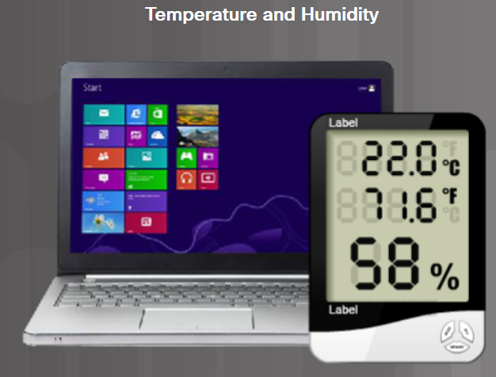
PC Preventive Maintenance Overview Preventive Maintenance – Environmental Concerns
An optimal operating environment for a computer is clean, free of potential contaminants, and within the temperature and humidity range specified by the manufacturer.
Notes:
4.1 – Preventive Maintenance
4.1.1 – PC Preventive Maintenance Overview
4.1.1.4 – Preventive Maintenance – Environmental Concerns

Slide 18
PC Preventive Maintenance Overview Preventive Maintenance – Software
Verify that installed software is current.
Follow the policies of the organization when installing security updates, operating system, and program updates.
Create a software maintenance schedule to:
Review and install the appropriate security, software, and driver updates.
Update the virus definition files and scan for viruses and spyware.
Remove unwanted or unused programs.
Scan hard drives for errors and defragment hard drives.
Notes:
4.1 – Preventive Maintenance
4.1.1 – PC Preventive Maintenance Overview
4.1.1.5 – Preventive Maintenance – Software
4.1.1.6 – Check Your Understanding – Preventive Maintenance

Slide 19
4.2 Troubleshooting Process
Notes:
4 – Preventive Maintenance and Troubleshooting
4.2 – Troubleshooting Process
4.2.1 Troubleshooting Process Steps

Slide 20

Troubleshooting Process Steps Introduction to Troubleshooting
Troubleshooting requires an organized and logical approach to problems with computers and other components.
Troubleshooting is a skill refined over time.
Before you begin troubleshooting problems, always follow the necessary precautions to protect data on a computer.
Notes:
4.2 – Troubleshooting Process
4.2.1 Troubleshooting Process Steps
4.2.1.1 Introduction to Troubleshooting

Slide 21
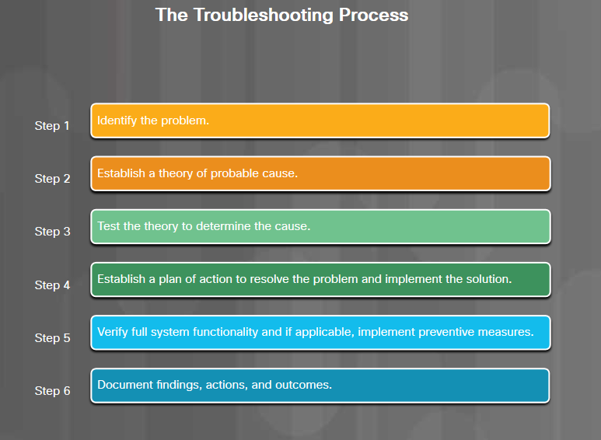
Troubleshooting Process Steps
Notes:
4.2 – Troubleshooting Process
4.2.1 Troubleshooting Process Steps
4.2.1.2 Troubleshooting Process Steps

Slide 22
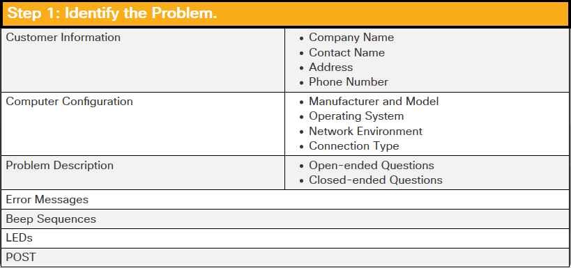
Troubleshooting Process Steps Identify the Problem
Notes:
4.2 – Troubleshooting Process
4.2.1 Troubleshooting Process Steps
4.2.1.3 Identify the Problem
4.2.1.4 – Check Your Understanding – Identify the Problem

Slide 23
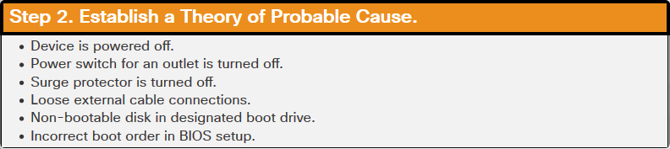
Troubleshooting Process Steps Establish a Theory of Probable Cause
Notes:
4.2 – Troubleshooting Process
4.2.1 Troubleshooting Process Steps
4.2.1.5 Establish a Theory of Probable Cause

Slide 24
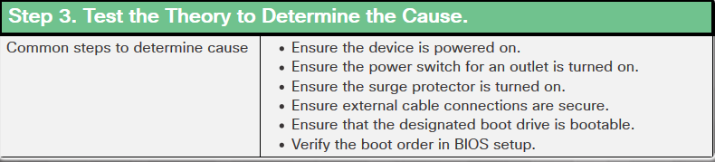
Troubleshooting Process Steps Test the Theory to Determine the Cause
Notes:
4.2 – Troubleshooting Process
4.2.1 Troubleshooting Process Steps
4.2.1.6 Test the Theory to Determine the Cause

Slide 25
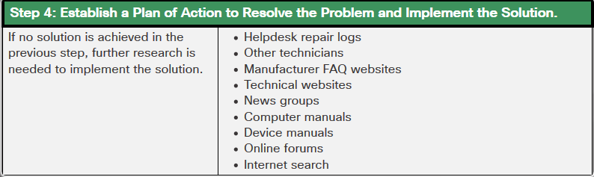
Troubleshooting Process Steps Establish a Plan of Action to Resolve the Problem and Implement the Solution
Notes:
4.2 – Troubleshooting Process
4.2.1 Troubleshooting Process Steps
4.2.1.7 Establish a plan of action to resolve the problem and implement the solution

Slide 26
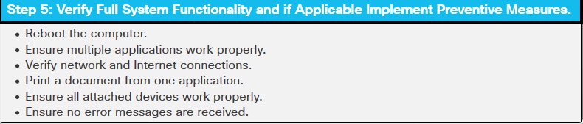
Troubleshooting Process Steps Verify Full Functionality and, If Applicable, Implement Preventive Measures
Notes:
4.2 – Troubleshooting Process
4.2.1 Troubleshooting Process Steps
4.2.1.8 Verify Full Functionality and, If Applicable, Implement Preventive Measures

Slide 27
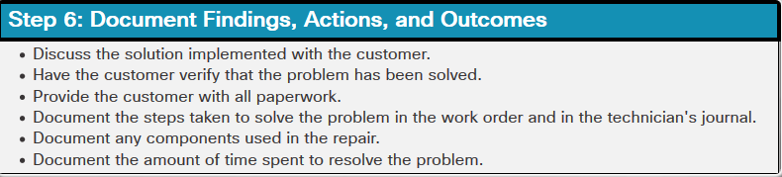
Troubleshooting Process Steps Document Findings, Actions, and Outcomes
Notes:
4.2 – Troubleshooting Process
4.2.1 Troubleshooting Process Steps
4.2.1.9 Document Findings, Actions, and Outcomes
4.2.1.10 – Check Your Understanding – Number the Steps

Slide 28
Common Problems and Solutions for PCs PC Common Problems and Solutions
Computer problems can be attributed to hardware, software, networks, or some combination of the three. These are some common hardware problems:
Storage Device - Storage device problems are often related to loose, or incorrect cable connections, incorrect drive and media formats, and incorrect jumper and BIOS settings.
Motherboard and Internal Components - These problems are often caused by incorrect or loose cables, failed components, incorrect drivers, and corrupted updates.
Power Supply - Power problems are often caused by a faulty power supply, loose connections, and inadequate wattage.
CPU and Memory - Processor and memory problems are often caused by faulty installations, incorrect BIOS settings, inadequate cooling and ventilation, and compatibility issues.
Displays – Display problems are often caused by incorrect settings, loose connections, and incorrect or corrupted drivers.
Notes:
4.2 – Troubleshooting Process
4.2.2 – PC Common Problems and Solutions
4.2.2.1 - PC Common Problems and Solutions

Slide 29
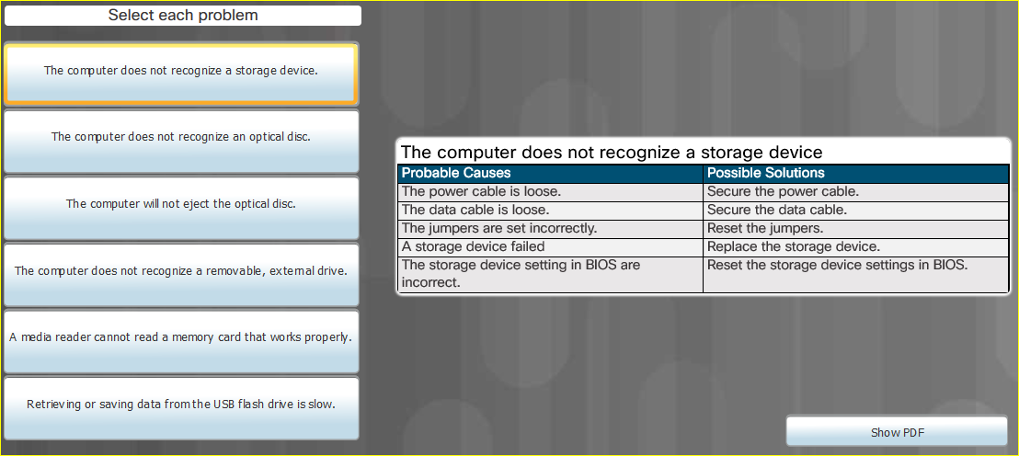
Common Problems and Solutions for PCs Common Problems and Solutions for Storage Devices
Notes:
4.2 – Troubleshooting Process
4.2.2 – PC Common Problems and Solutions
4.2.2.2 - Common Problems and Solutions for Storage Devices

Slide 30
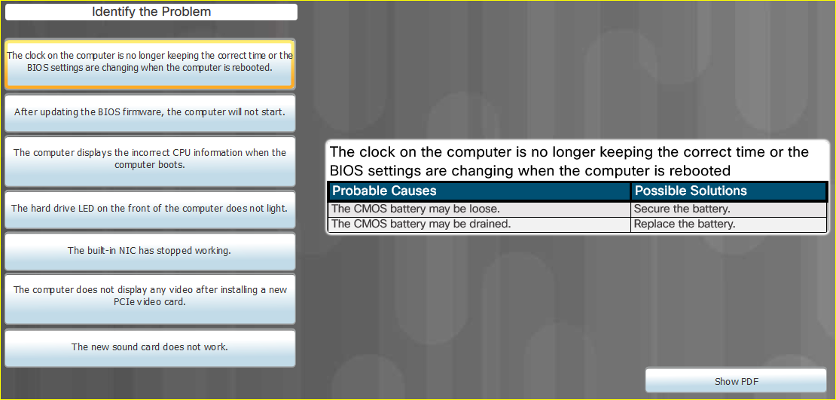
Common Problems and Solutions for PCs Common Problems and Solutions for Motherboards and Internal Components
Notes:
4.2 – Troubleshooting Process
4.2.2 – PC Common Problems and Solutions
4.2.2.3 - Common Problems and Solutions for Motherboards and Internal Components

Slide 31
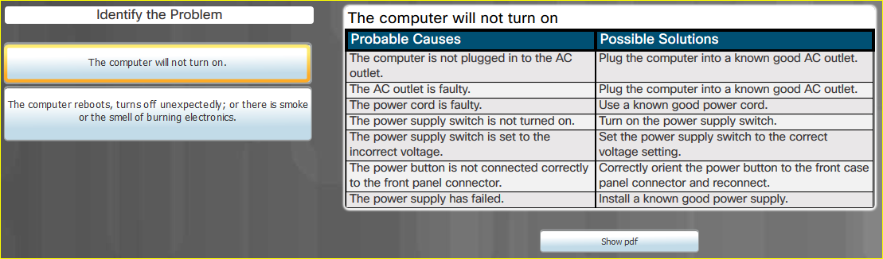
Common Problems and Solutions for PCs Common Problems and Solutions for Power Supplies
Notes:
4.2 – Troubleshooting Process
4.2.2 – PC Common Problems and Solutions
4.2.2.4 - Common Problems and Solutions for Power Supplies

Slide 32
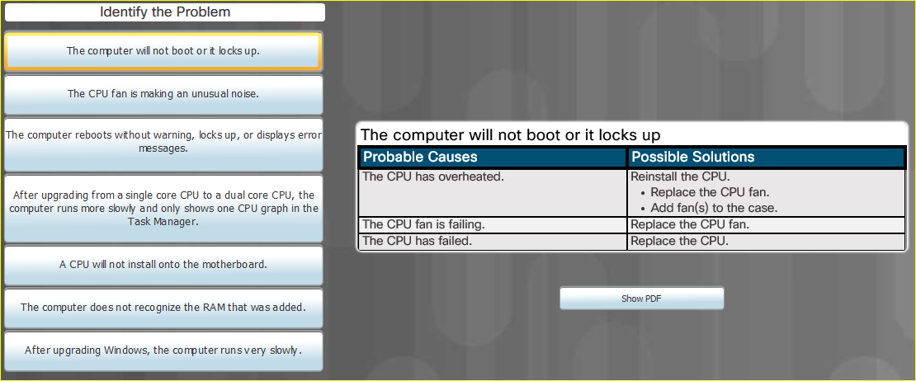
Common Problems and Solutions for PCs Common Problems and Solutions for CPUs and Memory
Notes:
4.2 – Troubleshooting Process
4.2.2 – PC Common Problems and Solutions
4.2.2.5 - Common Problems and Solutions for CPUs and Memory

Slide 33
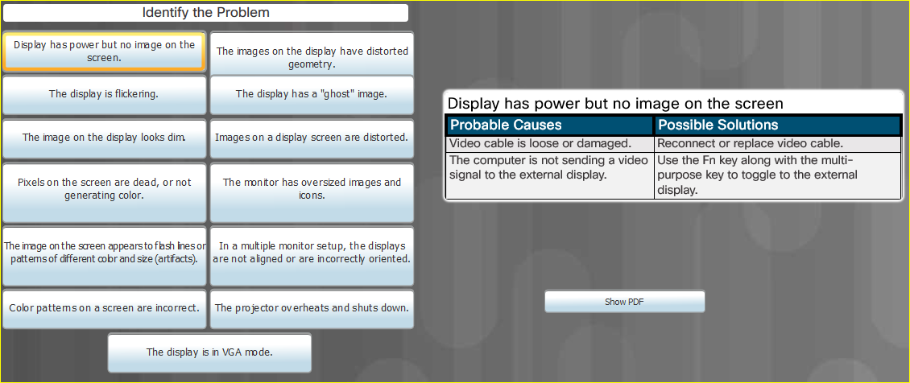
Common Problems and Solutions for PCs Common Problems and Solutions for Displays
Notes:
4.2 – Troubleshooting Process
4.2.2 – PC Common Problems and Solutions
4.2.2.6 - Common Problems and Solutions for Displays

Slide 34
Apply Troubleshooting Process to Computer Components and Peripherals Personal Reference Tools
Personal reference tools include troubleshooting guides, manufacturer manuals, quick reference guides, and repair journals. In addition to an invoice, a technician keeps a journal of upgrades and repairs:
Notes - Make notes as you go through the troubleshooting and repair process. Refer to these notes to avoid repeating steps and to determine what needs to be done next.
Journal - Include descriptions of the problem, possible solutions that have been tried to correct the problem, and the steps taken to repair the problem. Note any configuration changes made to the equipment and any replacement parts used in the repair. Your journal, along with your notes, can be valuable when you encounter similar situations in the future.
History of repairs - Make a detailed list of problems and repairs, including the date, replacement parts, and customer information. The history allows a technician to determine what work has been performed on a specific computer in the past.
Notes:
4.2 – Troubleshooting Process
4.2.3 – Apply Troubleshooting Process to Computer Components and Peripherals
4.2.3.1 – Personal Reference Tools

Slide 35
Apply Troubleshooting Process to Computer Components and Peripherals Internet Reference Tools
The Internet is an excellent source of information about specific hardware problems and possible solutions:
Internet search engines
News groups
Manufacturer FAQs
Online computer manuals
Online forums and chat
Technical websites
Notes:
4.2 – Troubleshooting Process
4.2.3 – Apply Troubleshooting Process to Computer Components and Peripherals
4.2.3.2 – Internet Reference Tools
4.2.3.3 – Check Your Understanding – Reference Tools

Slide 36
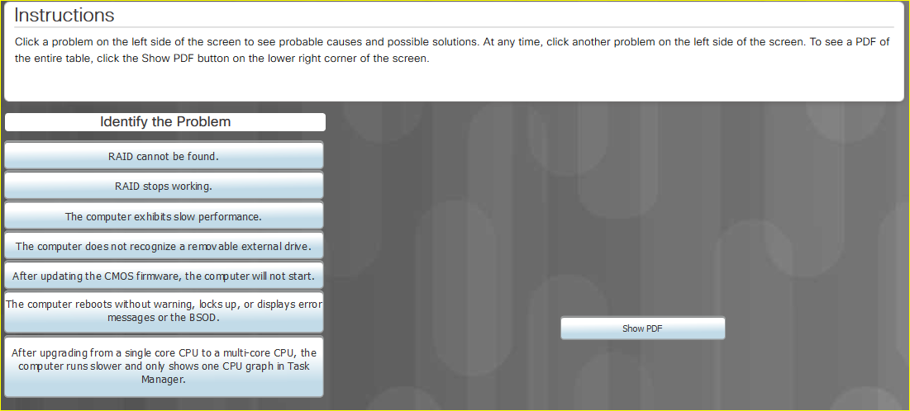
Apply Troubleshooting Process to Computer Components and Peripherals Advanced Problems and Solutions for Hardware
Notes:
4.2 – Troubleshooting Process
4.2.3 – Apply Troubleshooting Process to Computer Components and Peripherals
4.2.3.4 – Advanced Problems and Solutions for Hardware

Slide 37
Apply Troubleshooting Process to Computer Components and Peripherals Lab – Using a Multimeter and a Power Supply Tester
In this lab, you will learn how to use and handle a multimeter and a power supply tester.
Notes:
4.2 – Troubleshooting Process
4.2.3 – Apply Troubleshooting Process to Computer Components and Peripherals
4.2.3.5 – Lab – Using a Multimeter and a Power Supply Tester

Slide 38
Apply Troubleshooting Process to Computer Components and Peripherals Lab – Troubleshoot Hardware Problems
In this lab, you will diagnose the cause of various hardware problems and solve them.
Notes:
4.2 – Troubleshooting Process
4.2.3 – Apply Troubleshooting Process to Computer Components and Peripherals
4.2.3.6 – Lab – Troubleshoot Hardware Problems

Slide 39
4.3 Chapter Summary
Notes:
4 – Preventive Maintenance and Troubleshooting
4.3 – Chapter Summary

Slide 40
Conclusion Chapter 4: Preventive Maintenance and Troubleshooting
4.1 Preventive Maintenance
Explain why preventive maintenance must be performed on personal computers.
Describe PC preventive maintenance.
4.2 Troubleshooting Process
Troubleshoot problems with PC and Peripheral devices
Describe each step of the troubleshooting process.
Identify common problems and solutions for PCs.
Troubleshoot computer components and peripherals using the six-step troubleshooting process.
Notes:
4.3 – Chapter Summary
4.3.1 – Conclusion
4.3.1.1 – Chapter 4: Preventive Maintenance and Troubleshooting

Slide 41
Chapter 4 New Terms and Commands
Closed-Ended Questions Open-Ended Questions
Notes:
Chapter 4 - New Terms and Commands

